Slide 1
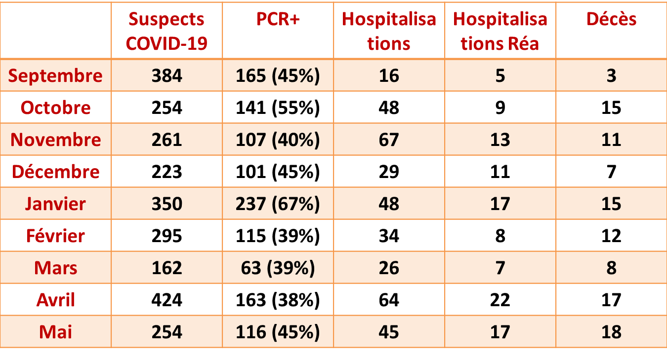
patients consultants aux urgences

